Slide 1



THE DEVELOPERS
PUSHPAK GOEL 2202901520128
PULKIT GAHLOT 2202901520127
PRACHI PANDEY 2202901520118
VEHICLE LOCKING/UNLOCKING AND MONITORING APPLICATION

Slide 2
INDEX
Title
Index
Introduction
Problem Statement
Motivation
Literature survey
Methodology
Result
Future Scope
Acknowledge

Slide 3
Introduction
VSECURE IS A REVOLUTIONARY MECHANISM DESIGNED WITH THE OBJECTIVE KEEPING THE VEHICLE SAFE EVEN WHILE THE USER IS AWAY BY GIVING THE REAL TIME ACCESS OF THE VEHICLE WHETHER IT IS LOCKED OR UNLOCKED TO THE USER. AN APP CAPABLE OF TRACKING, MONITORING AND CONTROLLING YOUR VEHICLE. IT PROVIDES REMOTE ACCESS TO THE USER SO THAT IT CAN BE OPERATED FROM A LARGE RANGE. IT IS EQUIPPED WITH THE SECURITY SYSTEM AND WHICH ALERTS THEUSER EVERYTIME THE VEHICLE IS UNDER ANY THREAT. THE WEBSITE WILL REFLECT THE INSTANTANEOUS STATUS OF THE VEHICLE. ALSO, IT CAN UPDATE THE USER ABOUT EVERYCHANGE IN THE STATE OF THE VEHICLE THROUGH THE APP IN REAL TIME.

Slide 4
PROBLEM STATEMENT
CREATE A WEB/MOBILE APPLICATION CAPABLE OF MONITORING AND REMOTELY ACCESSING VEHICLE LOCK/UNLOCK STAGES. UTILIZE AN IOT SUPPORTED MICROCONTROLLER BOARD ALONG WITH RFID-BASED AUTHENTICATION FOR SIMULATING THE UNLOCK/LOCK PROCESS AND PROVIDING ESSENTIAL INFORMATION TO THE WEB APPLICATION.

Slide 5
MOTIVATION
AS WE KNOW THAT NOWADAYS NOTHING IS MUCH SAFE AND SO OUR VEHICLES. WE SEE AND HEAR THE NEWS OF VEHICLE STOLEN ALMOST EVERYDAY IN OUR LIVES. IN FACT, OVER 1,00,000 VEHICLES GET STOLEN IN INDIA EVERY YEAR. BUT IT’S THE TIME TO NOT JUST FACE BUT ELIMINATE THIS TREND. WE HAVE CREATED VSECURE WHICH KEEPS YOUR VEHICLE SECURE WHEN YOU ARE AWAY

Slide 6
METHODOLOGY
THE USER SCANS RFID TAG AT THE RFID READER. IT SEND THE INFORMATION TO THE ARDUINO. ARDUINO CONFIRMS THAT THE INPUT ID IS VALID OR NOT, THEN OPENS OR CLOSE THE LOCK. THEN, IT UPDATES THE CURRENT STATUS OF LOCK ON THE INTERNET. FROM INTERNET, OUR WEBSITE CAN FETCH THIS INFORMATION AND PROVIDE IT TO THE USER.

Slide 7

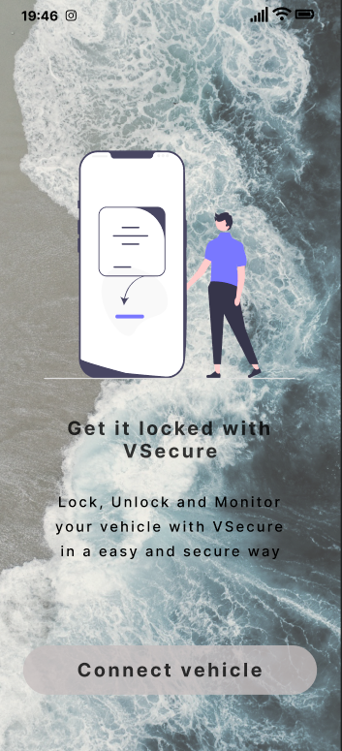
VSECURE
A MOBILE APPLICATION THAT ENSURE THE SECURITY OF YOUR VEHICLE ON THE GO . NOW KEEP A TRACK OF YOUR VEHICLE SECURITY FROM ANYWHERE WITH JUST FEW CLICKS.

Slide 8
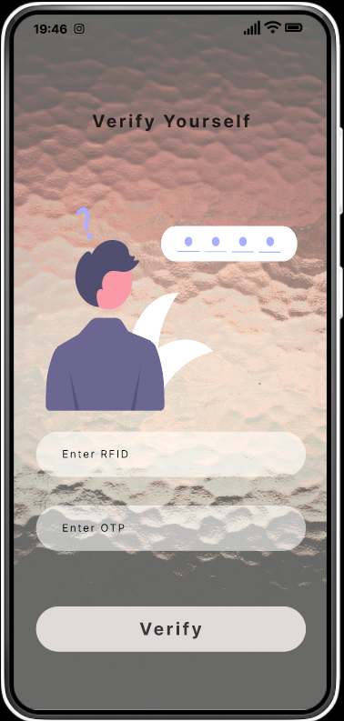



A USER- FRIENDLY APPLICATION
A minimalistic Application for the users to control vehicle locks from anywhere.
A very user friendly and light weight application for vehicle security.

Slide 9



TECH STACK AND COMPONENTS
01
ARDUINO
02
RFID READER AND TAG
03
RELAY CHANNEL
04
SOLENOID LOCK
05
FLUTTER
06
NODE.JS
07
POWER SOURCE

Slide 10
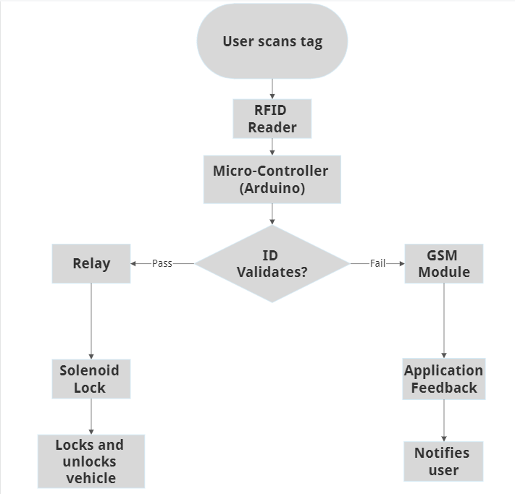
INPUTS AND SYSTEM OUTPUTS

Slide 11

THANK
YOU
ANY QUESTIONS?

